Slide 1
System Administration
Inventory Management
& Labor Management
WMS Guide

Slide 2
Table of Contents
Inventory Management.………..…………….……...............................................................3
Item UOM Maintenance………..…………….……...................................................3
Item Volumetrics Maintenance.………..…………..…..........................................12
Inventory Volumetrics Maintenance..…..……..…............................................19
Inventory Status Modification…………………………………………………………………..26
Labor Management.……………………………………………………………...……………………….…...45
Task Management.……………………………………………………………………………………45

Slide 3
Inventory Management
Item UOM Maintenance
Back to the Table of Contents

Slide 4
Item UOM Maintenance
The Item UOM Maintenance view is an item maintenance view that allows modification of item unit of measure (UOM) data even if there is inventory for this item in the warehouse.
This allows for changes to all UOM descriptors except for UOM 1.
The maintenance of UOM is not allowed when there is one or more queued command(s) in the WMS for this item.
Changes to the item UOM descriptors through this view will automatically update all the existing inventory for this item in the system.

Slide 5
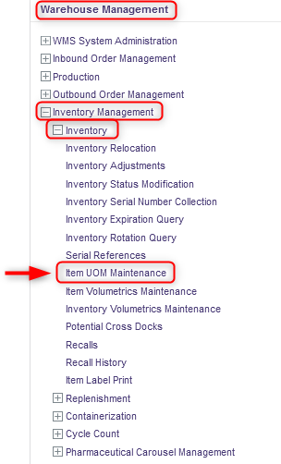
Item UOM Maintenance
With a desktop computer, use the Warehouse Management menu.
Select the Inventory Management resource.
Under Inventory Management, click on Inventory.
Under Inventory, click on Item UOM Maintenance.

Slide 6
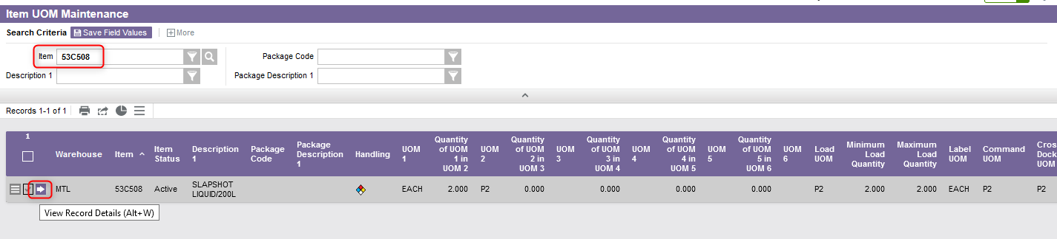
Item UOM Maintenance
Perform a search to retrieve the item you wish to update and click on View Record Details.

Slide 7
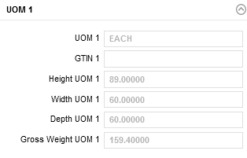
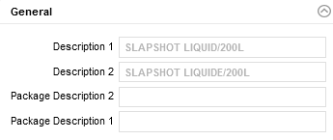
Item UOM Maintenance
In the new window that appears, note that the General and UOM 1 sections will be grayed out and cannot be modified if you are updating an item for which there is inventory in the warehouse.

Slide 8
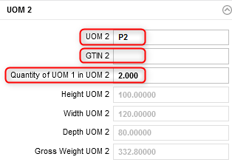
Item UOM Maintenance
In the UOM 2 section, update the desired fields as follows:
The level 2 unit of measure.
The unique identifier for the item's UOM 2 according to the GS1 Global Trade Item Number standards.
The number of UOM 1 it takes to make one UOM 2.

Slide 9
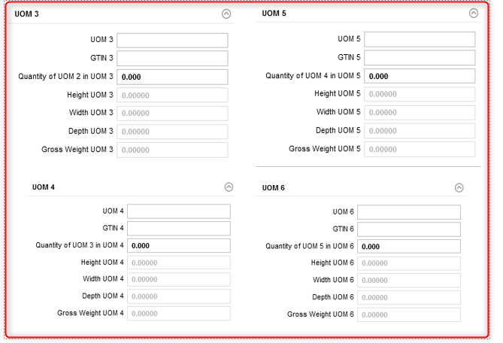
Item UOM Maintenance
Repeat the step 7 for the UOM 3 to UOM 6 sections as needed.

Slide 10
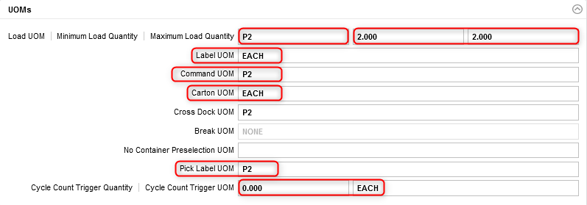
Item UOM Maintenance
In the UOMs section, update the desired fields as follows:
Minimum and maximum quantity (in the lowest UOM) of inventory that can be associated with a full load for the item.
Quantity per Tag which defines the unit of measure for which a tag ID is generated.
UOM for which tag labels are printed on a receipt record.
Commands are displayed to users in this UOM whenever possible.
UOM that defines a shipping carton that can be shipped directly to a customer as is.
Cycle count trigger quantity for an item and its corresponding UOM.
The largest unit of measure for which a pick label will be printed.

Slide 11
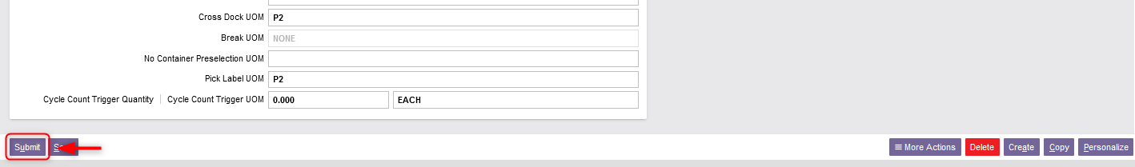
Item UOM Maintenance
Once all the required fields in the sections have been completed, click Submit.
Click on Close to exit the Item UOM Maintenance resource.

Slide 12
Inventory Management
Item Volumetrics Maintenance
Back to the Table of Contents

Slide 13
Item Volumetrics Maintenance
The Item Volumetrics Maintenance view is an item maintenance view that enables the modification of item volumetrics data even if there is inventory for this item in the warehouse.
This view allows changes to the dimensions and weight of each UOM.
The maintenance of item volumetrics is not allowed when there is one or more queued command(s) in the WMS for this item.
Changes to the item volumetrics through this view will be applied to all new inventory. If you wish to change some or all the existing inventory records with new volumetrics, this can be achieved through the Inventory Volumetrics Maintenance resource.

Slide 14
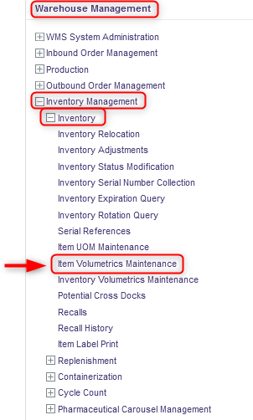
Item Volumetrics Maintenance
With a desktop computer, use the Warehouse Management menu.
Select the Inventory Management resource.
Under Inventory Management, click on Inventory.
Under Inventory, click on Item Volumetrics Maintenance.

Slide 15
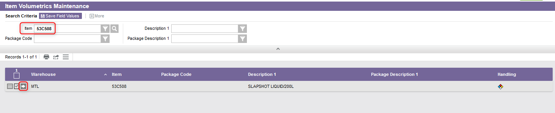
Item Volumetrics Maintenance
Perform a search to retrieve the item you wish to update and click on View Record Details.

Slide 16
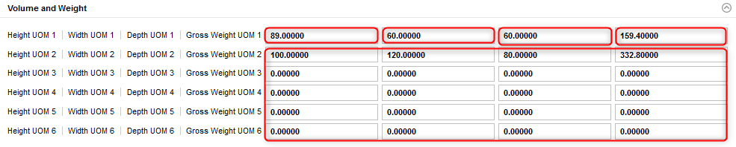
Item Volumetrics Maintenance
In the Volume and Weight section, update the desired fields as follows:
The level 1 height of the specified UOM inventory.
The level 1 width of the specified UOM inventory.
The level 1 depth of the specified UOM inventory.
The level 1 gross weight of the specified UOM inventory.
The level 2 to 6 height/width/depth/gross weight of the specified UOM inventory (if applicable).

Slide 17
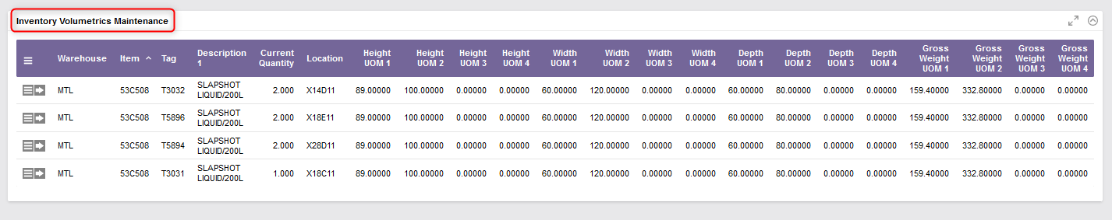
Item Volumetrics Maintenance
Once the Volume and Weight section updated, you also have the option to update the Inventory Volumetrics Maintenance section. Note that this second section corresponds to the Inventory Volumetrics Maintenance resource available in the WMS: refer to the next section of this document to complete this step.

Slide 18
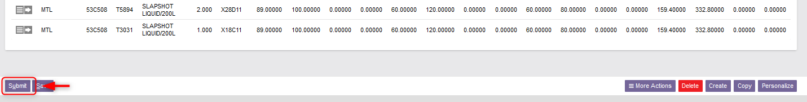
Item Volumetrics Maintenance
Once all the required fields in the sections have been completed, click Submit.
Click Close to exit the Item Volumetrics Maintenance resource.

Slide 19
Inventory Management
Inventory Volumetrics Maintenance
Back to the Table of Contents

Slide 20
Inventory Volumetrics Maintenance
While the Item Volumetrics Maintenance resource (explained in the previous section) will apply the changes to all new inventory, the Inventory Volumetrics Maintenance view allows modification of existing inventory with the current item unit volumetric data.
Therefore, if you wish your old inventory to remain at the same UOM, you should not realize this resource. In this way, having performed the Item Volumetrics Maintenance resource beforehand, only the new inventory received for this item will be updated with the new UOM(s).
Changes to existing inventory that has already been picked are not supported. If required, unpick or repack procedures are required to update this data.

Slide 21
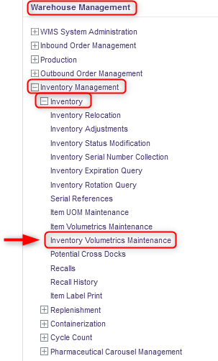
Inventory Volumetrics Maintenance
With a desktop computer, use the Warehouse Management menu.
Select the Inventory Management resource.
Under Inventory Management, click on Inventory.
Under Inventory, click on Inventory Volumetrics Maintenance.

Slide 22
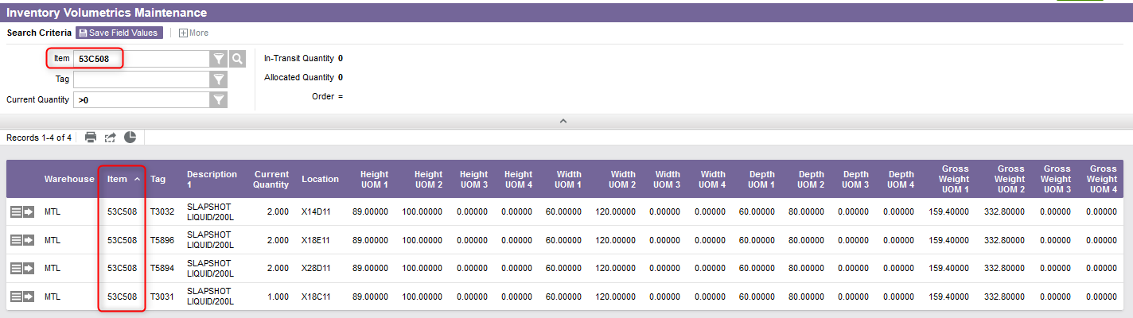
Inventory Volumetrics Maintenance
Perform a search to retrieve the item you wish to update.

Slide 23
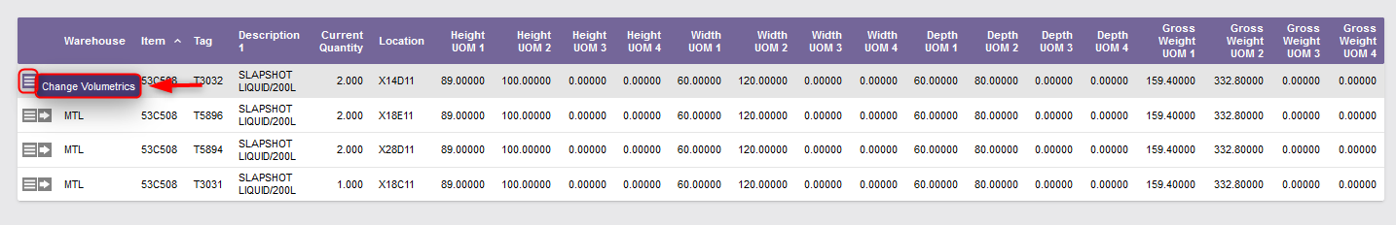

Inventory Volumetrics Maintenance
Choose the line of inventory you wish to update.
Select the Use Record as Criteria for Action button and click on the Change Volumetrics action.
A confirmation message will appear:

Slide 24
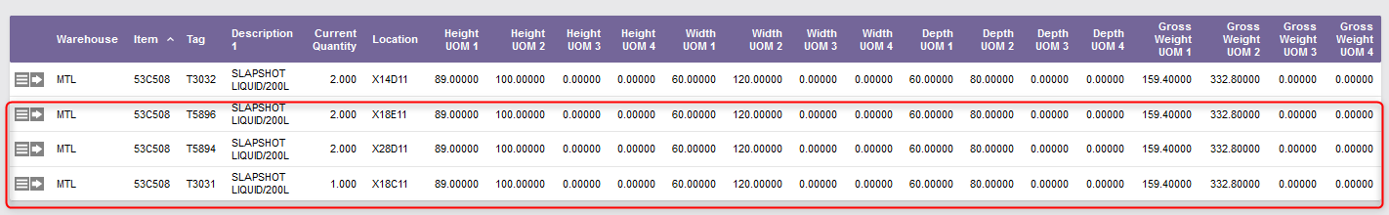
Inventory Volumetrics Maintenance
Repeat steps 6 and 7 for each inventory line of items for which you wish to update the volumetrics data.
Note: As explained previously, these steps can be performed directly from the Item Volumetrics Maintenance resource if desired.

Slide 25
Inventory Volumetrics Maintenance
Once all the desired volumetrics data updated, click on Close to exit the Inventory Volumetrics Maintenance resource.

Slide 26
Inventory Management
Inventory Status Modification
Back to the Table of Contents

Slide 27
Inventory Status Modification
The Inventory Status Modification resource allows a user to modify the attributes of inventory records.
  Attributes that may be changed are the reason code, the hold code, the receipt date and time, the item expiration date associated with the inventory and/or other inventory attributes.
You have the choice to modify the status of a single inventory record or multiple inventory records at once.
  Example: When the expiration date is changed for a tag which is a lot-controlled item, the system will change it for every record with the same lot-controlled item.

Slide 28
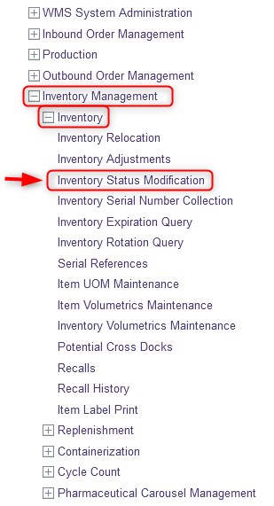
Inventory Status Modification
With a desktop computer, use the Warehouse Management menu.
Select the Inventory Management resource.
Under Inventory Management, click on Inventory.
Under Inventory, click on Inventory Status Modification.

Slide 29
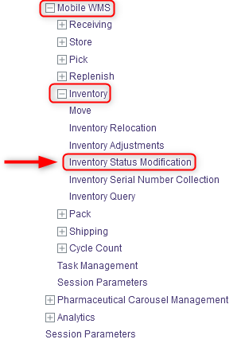
Inventory Status Modification
Note that you can also use this resource through a mobile device:
With a mobile device, select the Inventory resource.
Under Inventory, click on Inventory Status Modification.
The procedural steps and system behavior are the same for both the desktop and mobile device processes. Follow the same steps starting from the next slide.

Slide 30
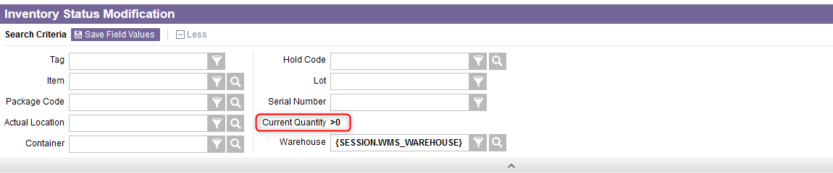
Inventory Status Modification
Additional Note – Once the resource is open, by clicking on in the search criteria section, you may notice that the Current Quantity field has been assigned a permanent search criteria value of >0. This is used to restrict the selection to positive current inventory records only.

Slide 31
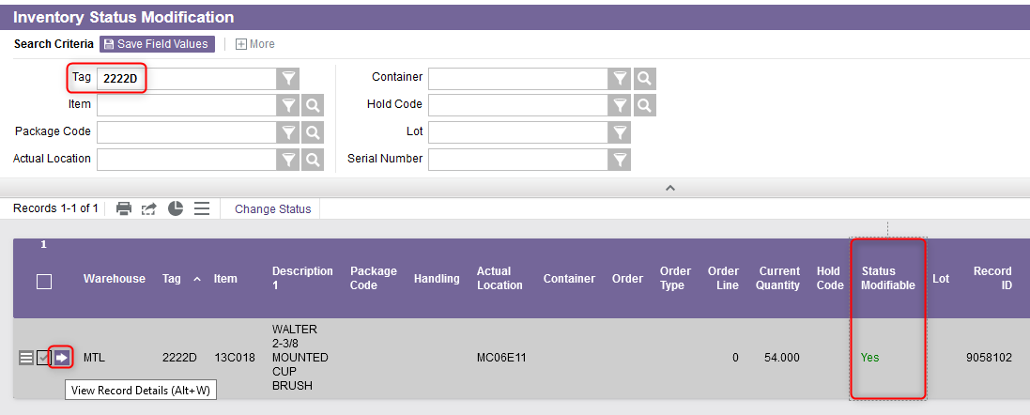
Inventory Status Modification
In the new window, the inventory records in the WMS will be listed.
If you want to update the status of only one inventory record, do this:
6.1 Use the search criteria by using either the Tag or Item identifier to retrieve the desired instance of inventory and click on click on View Record Details. Note that only inventory identified as “Status Modifiable” can be selected.

Slide 32
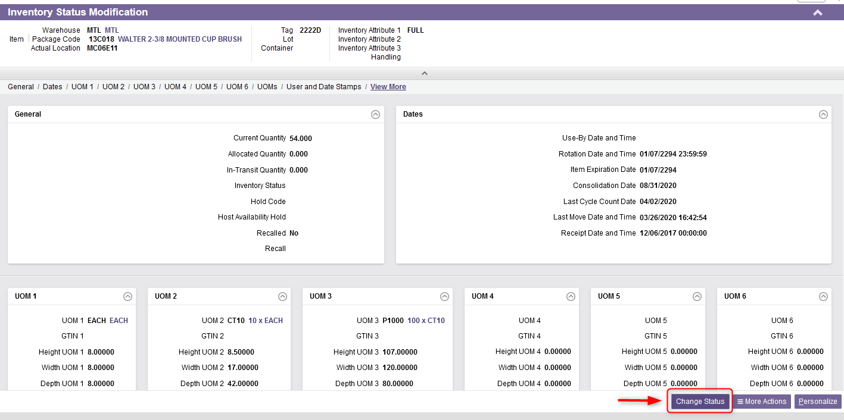
Inventory Status Modification
6.2 From the Record Details view of the inventory record, click on Change Status in the lower right corner.

Slide 33
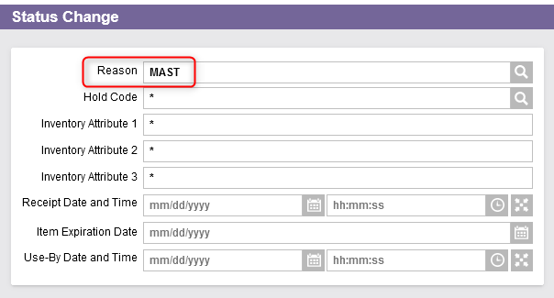
Inventory Status Modification
6.3 From the new window, you need first to enter a Reason code. The reason code must be entered in this field to indicate why the change is being made, or why the inventory is being adjusted or moved.

Slide 34
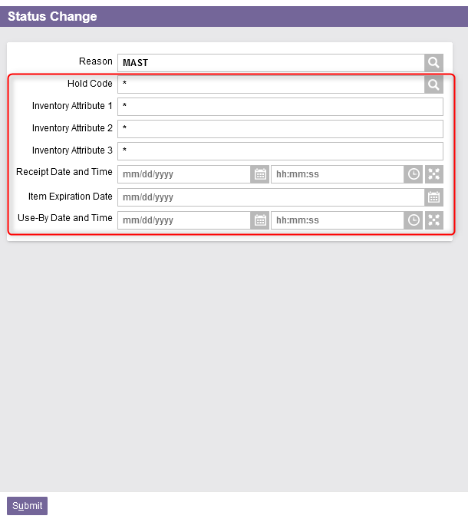
Inventory Status Modification
6.4 Then, you can modify any of the information for the displayed fields: Hold Code, Inventory Attribute 1/2/3, Receipt Date and Time, Item Expiration Date, Use By Date and Time.

Slide 35
Inventory Status Modification
6.4 (Continued).
For the Hold Code and Inventory Attribute 1/2/3 fields, update the fields as follows:
  Leave an asterisk (*) to indicate that the values for the field should not be changed,
  Clear the field to indicate that the field should be blanked out,
  Enter a new value in the field to update the values for the field with the specified entry.
For the Receipt Date and Time, Item Expiration Date and Use-By Date and Time fields, update the fields as follows:
  Leave the field empty to indicate that no modification is necessary,
  Enter a new value in the field to update the values for the field with the specified entry.

Slide 36
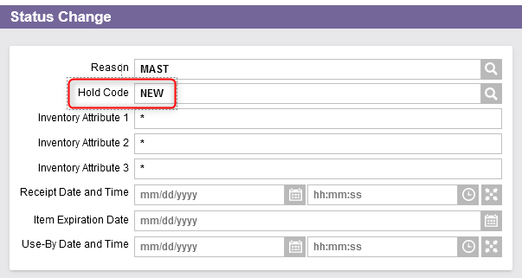
Inventory Status Modification
6.4 (Continued)
  Hold Code: This is the hold code of a full or partial load. This provides a means to identify inventory that is to be kept separate from similar inventory for disposal, a return to the vendor, testing, or inspection purposes.

Slide 37
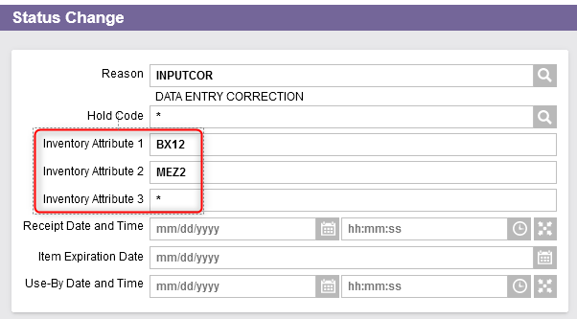
Inventory Status Modification
6.4 (Continued)
  Inventory Attribute 1/2/3: These fields correspond to user-defined attributes of inventory. They are used to differentiate inventory records of the same item/package code.

Slide 38
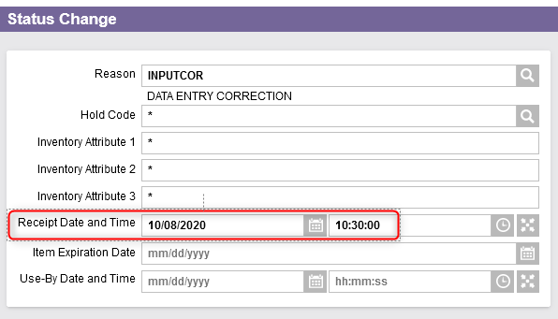
Inventory Status Modification
6.4 (Continued)
  Receipt Date and Time: This is the date and time of the receipt.

Slide 39
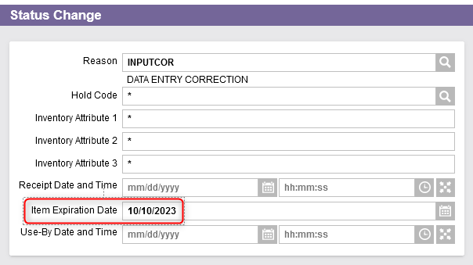
Inventory Status Modification
6.4 (Continued)
  Item Expiration Date: This is the item expiration date from the manufacturer.

Slide 40
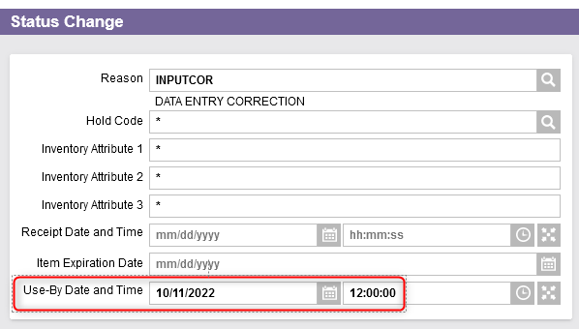
Inventory Status Modification
6.4 (Continued)
  Use-By Date and Time: This is the date and time by which the product needs to be consumed. This field is populated at the time of picking based on the item setup for the Use-By Days, Use-By Hours, and Auto-Assign Use-By Date and Time flags. It can also be assigned using the Inventory Status Change resource or through Express Returns.

Slide 41
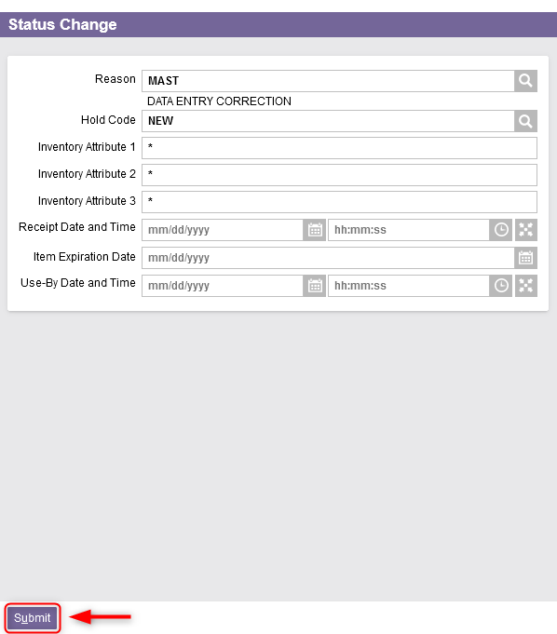
Inventory Status Modification
6.5 Once all the fields properly entered, click on Submit.
A confirmation message will appear and the change(s) will be applied to the inventory record.

Slide 42
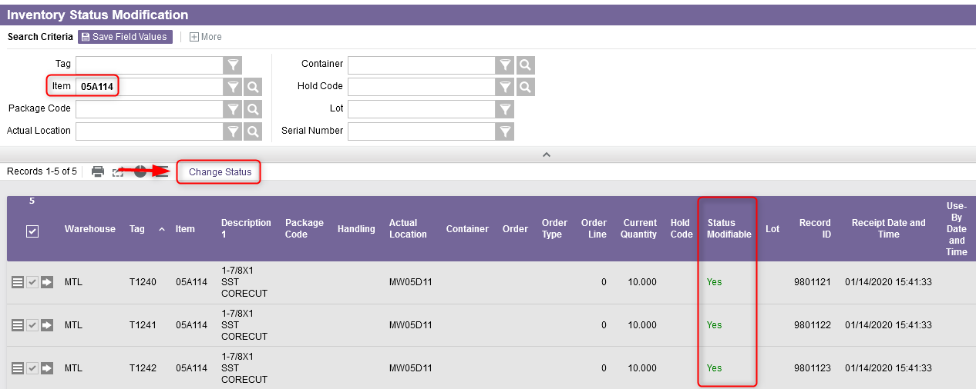
Inventory Status Modification
If you want to update the status of multiple inventory records at once, do this:
7.1 Use the search criteria to retrieve the instances of inventory you want to update and click on the Change Status button. Note that only records identified as “Status Modifiable” can be selected.

Slide 43
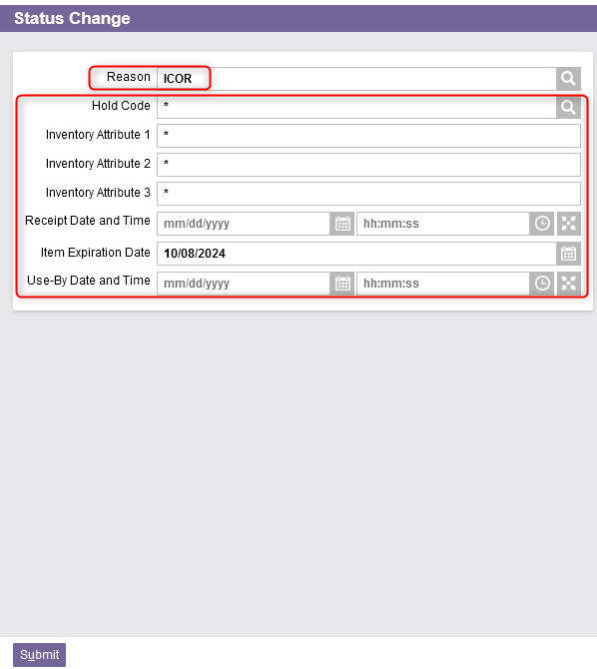
Inventory Status Modification
7.2 From the new window:
Enter a Reason code (refer to the slide 33 for details);
And modify any of the information for the displayed fields: Hold Code, Inventory Attribute 1/2/3, Receipt Date and Time, Item Expiration Date and/or Use By Date and Time (refer to the slides 34 to 40 for details).

Slide 44
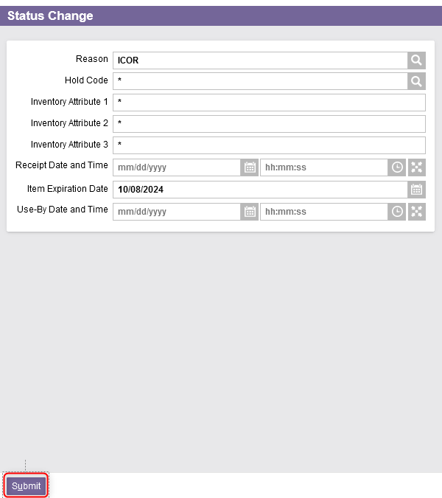
Inventory Status Modification
7.3 Once all the fields properly entered, click on Submit.
A confirmation message will appear and the change(s) will be applied to the selected inventory records.

Slide 45
Labor Management
Task Management
Back to the Table of Contents

Slide 46
Task Management
This resource is used to manage labor operations by prioritizing tasks given to users.
While a user may perform at any time any task to which the user is allowed access, a user who is specifically logged into the task management queue on a mobile computer will receive commands in a configured priority sequence.
What equipment a user is using, what functions the user is to perform, and what areas of the warehouse the user is to work in are all used to determine which commands are issued to that user.
The command types that are used may be: Store, Cycle Count, Replenishment, Pick, etc.

Slide 47
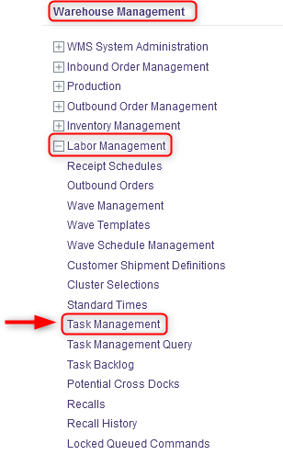
Task Management
With a desktop computer, use the Warehouse Management menu.
Select the Labor Management resource.
Under Labor Management, click on Task Management.

Slide 48
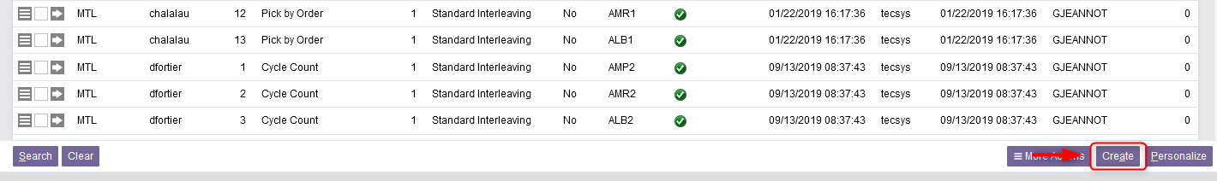
Task Management
In the new window, the different tasks for users will be listed.
If you want to assign a new task to a user, do this:
5.1 Click on Create at the bottom right of your screen.

Slide 49
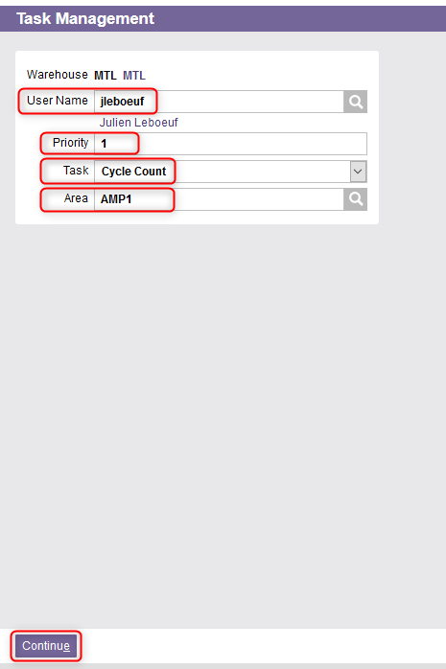
Task Management
5.2 From the new window, enter a valid User in the User Name field.
5.3 Enter the Priority, the Task Type to be performed and an Area, if applicable.
Priority: This is the priority in which the user receives commands. Priority 1 represents the highest priority in the system.
Area: This is the identification of the area in which the user is to perform tasks.
5.4 Click on Continue.

Slide 50
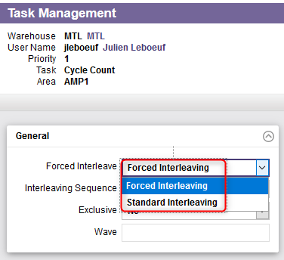
Task Management
5.5 A new window will appear. In the General section, enter the Forced Interleave type which specifies, for any two or more identical priorities, how tasks are interleaved for those priorities. An explanation is given in the next slide.

Slide 51
Task Management
5.5 (Continued)
Forced Interleaving indicates that tasks to be interleaved are to be forced. The system issues the highest priority command of one task type, and then the highest priority command of another task type, and then the highest priority command of a third task type (if three are specified), before issuing the next highest priority command of the first task type. The order in which the task types are issued to the user in forced interleaving is specified in the Sequence field.
Standard Interleaving indicates that the highest priority commands of the task types within the priority are to be issued, followed by the next highest priority commands, and so on, until all tasks of the specified task types are completed. Forced interleaving interleaves the task types, while standard interleaving ensures priority 1 work is completed before priority 2 tasks are commenced.
If the same priority is assigned to different task codes for a user, then this flag must be set to “Standard Interleaving”.

Slide 52
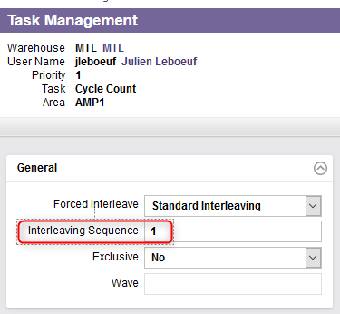
Task Management
5.6 Enter a value in the Interleaving Sequence field.
This is the command sequence number of the source location of the command. In other words, for forced interleaving, this is the sequence in which tasks of the same priority are issued to the user.

Slide 53
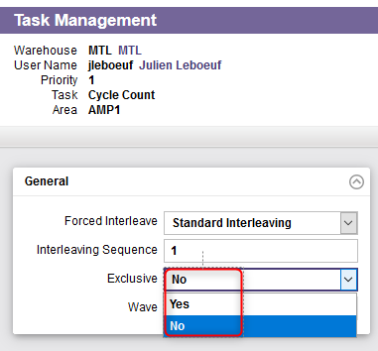
Task Management
5.7 Select Yes or No in the Exclusive field.
Yes indicates that the user should be the only person performing the specified task at any one time in the specified area.
No indicates that the user does not have exclusive access to the task type in the area.

Slide 54
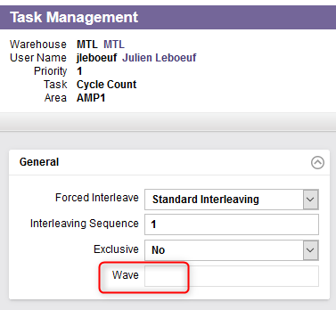
Task Management
5.8 Enter a Wave number if applicable.
The wave number specifies whether or not the task is to be performed by wave.
If a wave is specified, the user will only receive tasks for that wave.

Slide 55
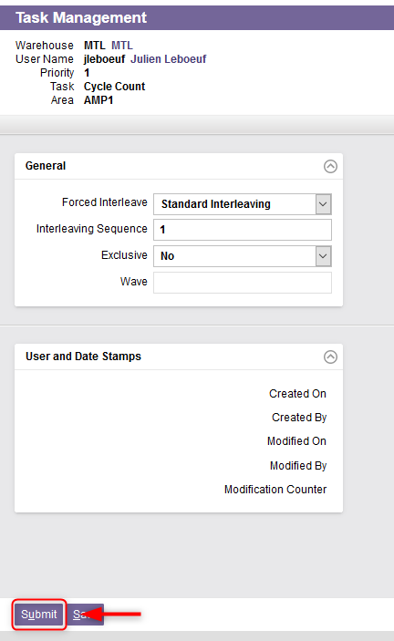
Task Management
5.9 Once all the fields properly entered, click on Submit.
A confirmation message will appear and the task will be assigned to the user.

Slide 56
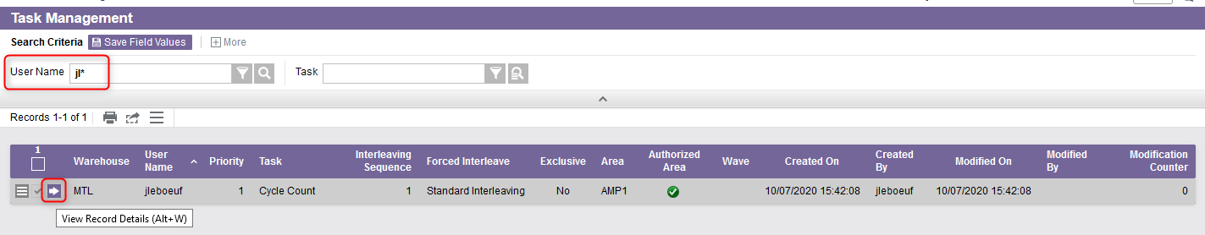
Task Management
If you want to update a task already assigned to a user, do this:
  6.1 Perform a search to retrieve the task using the User Name or Task in the search criteria bar, and click on View Record Details.

Slide 57
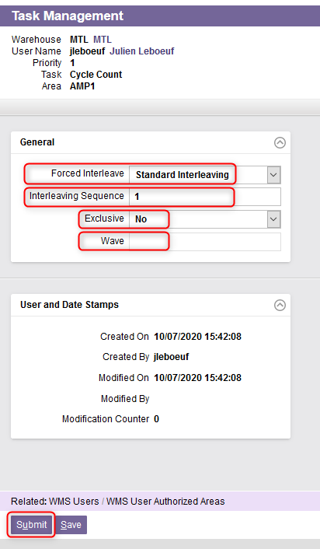
Task Management
6.2 From the new window, update the Forced Interleave, Interleaving Sequence, Exclusive and Wave fields. Refer to the slides 50 to 54 for more details on these fields.
6.3 Then click on Submit.
The task assignment has been updated.

